Slide 1
Schedules and Loadshapes
This section will introduce you to the loadshape and schedule objects.

Slide 2
Schedule Object
Implemented in the core
One of three primary ways of inputting data (others are players and shapers)
Represent a recurring pattern of values over time
  Minutes, hours, days, weeks, months

Slide 3
Schedules (cont.)
Define when a value is used
  “mm hh DD MM WW xx”
    DD = day of month, WW = day of week, xx = given value
  Sunday is day 0 and 7
  Holidays are day 8
Format of time specification: POSIX standard
  (similar to crontab format in UNIX)
  * 12 * * * noon every day
  * 12-15 * 1-4 * noon to 3pm Jan thru Apr
  * 15;18-5 * * 1-5 M-F 3pm and 6pm to 5am
Schedules blocks basis for normalization
Schedules blocks must be full (no gaps in time)
Size limitation of 63 nonzero unique values per block
Max number of 4 blocks

Slide 4
Example Schedule
schedule heating_schedule {
// winter weekdays
* 0-5 * 1-4;10-12 1-5 65; //sleep
* 6-8 * 1-4;10-12 1-5 70; //wake
* 9-17 * 1-4;10-12 1-5 60; //away
* 18-20 * 1-4;10-12 1-5 70; //wake
* 21-23 * 1-4;10-12 1-5 65; //sleep
// winter weekends
* 0-9;21-23 * 1-4;10-12 6-7 65; //sleep
* 10-20 * 1-4;10-12 6-7 70; //wake
// summer
* * * 5-9 * 60; //all summer
}

Slide 5
Schedule Implementation
There are two ways to use schedules
  Schedule transforms – uses a linear transformation to drive a object property from the current value of the schedule
  Loadshapes – uses a schedule to alter the energy or power parameter of a loadshape

Slide 6
Schedule Transforms
Works similar to targeting a player to an object property
  object house {
  heating_setpoint heating_schedule*x+b;
  }
Valid transforms are multiplication, addition, and subtraction.
Syntax and order are important!

Slide 7
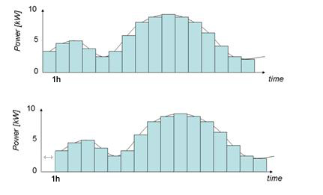
Schedule “skew”
NEW
Allows the user to create one schedule then “skew” the time (in seconds) on individual objects
Units are not specified
Each object has its own “skew” (0 is default)
  object house {
  schedule_skew 3600;
  heating_setpoint heating_schedule;
  }

Slide 8
Load shapes
Property – loadshape
  Are associated with schedules
  5 types
    Analog
    Pulsed
    Modulated (un-validated)
    Queued
    Scheduled

Slide 9
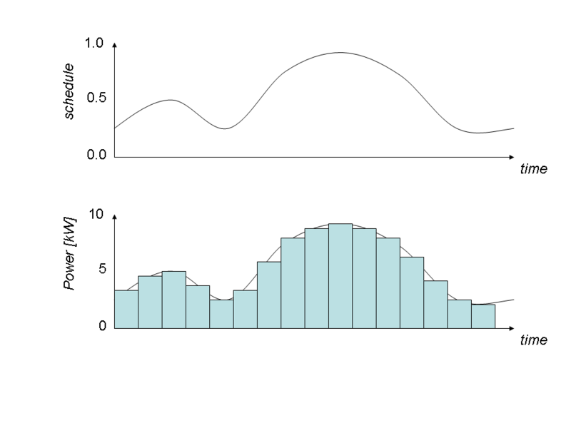
Analog Loadshapes
Analog loadshapes directly compute the power from the values in the schedule. An analog loadshape is defined using one of the three following methods:
class example {
loadshape myshape;
}
// Fixed scheduled energy in a block
object fixed-energy {
myshape "type: analog; schedule: schedule-name; energy: value kWh";
}
// Fixed power ( schedule value times the power value )
object scaled-power {
myshape "type: analog; schedule: schedule-name; power: value kW";
}
// Unscaled ( value in schedule is used directly )
object unscaled {
myshape "type: analog; schedule: schedule-name";
}

Slide 10
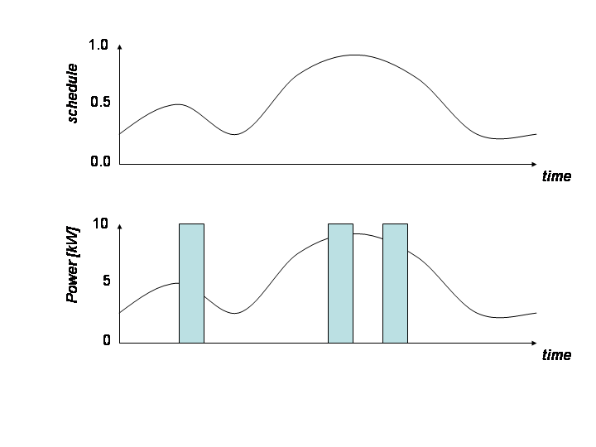
Pulsed
Pulsed loadshapes emit 1 or more pulses at random times such that the total energy is accumulated over the period of the loadshape. A pulsed loadshape is defined using one of the two following methods:
class example {
loadshape myshape;
}
// Constant pulse duration
object sample {
myshape "type: pulsed; schedule: schedule-name; energy: value kWh; count: value; duration: value s";
}
// Constant pulse power
object sample {
myshape "type: pulsed; schedule: schedule-name; energy: value kWh; count: value; power: value kW";
}
NOTE: Future implementations will include standard deviation of values.

Slide 11
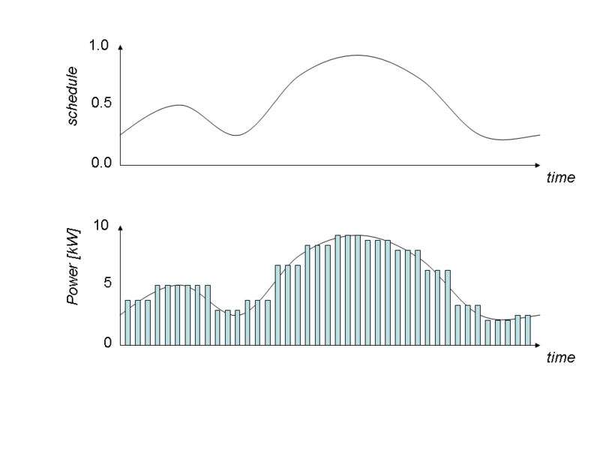
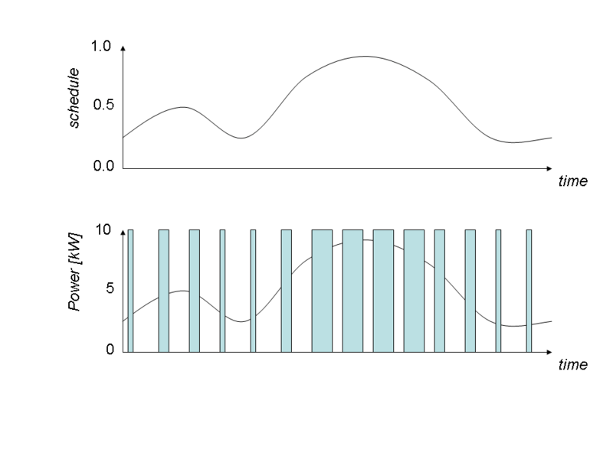
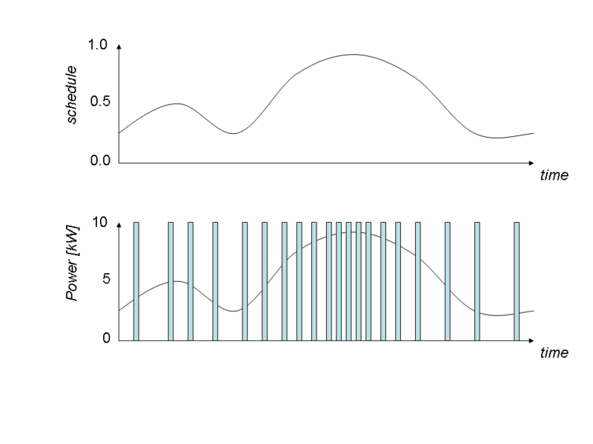
Modulated Loadshapes
Modulated loadshapes emit a continuous sequence of modulated pulses with either constant period and duty-cycle(amplitude), or constant power and on-time (pulsewidth), or constant power and period (frequency). A modulated loadshape is defined using the following terms:
class example {
loadshape myshape;
}
object sample {
myshape "type: modulated; modulation: modulation; schedule: schedule-name; energy: value kWh; count: value; period: value s";
}
object sample {
myshape "type: modulated; modulation: modulation; schedule: schedule-name; energy: value kWh; count: value; power: value kW";
}

Slide 12
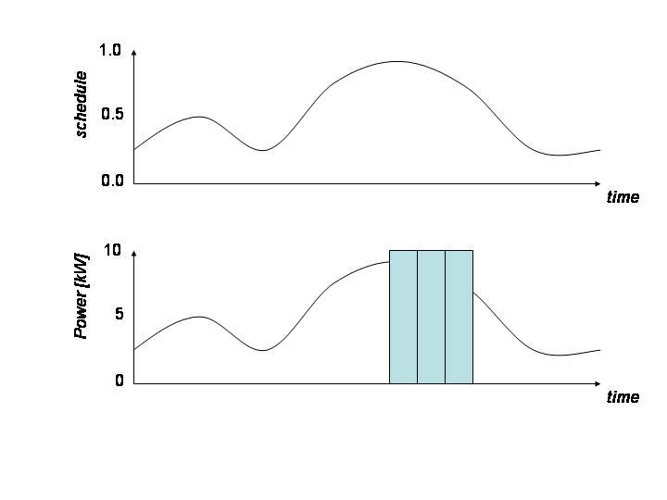
Queued Loadshapes
Queued loadshapes emit random pulses whenever a queue accrued from the loadshape reaches an on threshold and continues emitting pulses until the queue reaches an off threshold. A queued loadshape is defined using the following two methods:
class example {
loadshape myshape;
}
// Constant pulse duration
object sample {
myshape "type: pulsed; schedule: schedule-name; energy: value kWh; count: value; duration: value s; q_on: value; q_off: value";
}
// Constant pulse power
object sample {
myshape "type: pulsed; schedule: schedule-name; energy: value kWh; count: value; power: value kW; q_on: value; q_off: value";
}

Slide 13
Demo
// This demo uses a schedule for
// a plugload object and records the power demand and energy used
// by the object.
module tape;
module residential{
implicit_enduses NONE;
}
clock {
timezone PST+8PDT;
starttime '2001-01-01 00:00:00';
stoptime '2001-01-02 00:00:00';
}
schedule plug_shape {
* 0-2 * * * 0.15;
* 3-5 * * * 0.35;
* 6-8 * * * 0.70;
* 9-17 * * * 0.500;
* 18-20 * * * 0.86;
* 21-23 * * * 0.25;
}
object house {
object plugload {
shape "type: analog; schedule: plug_shape; power: 1kW";
object recorder {
property power,demand,energy;
interval 3600;
limit 24;
file plugload_energy_usage.csv;
};
power_factor 1.0; // Required to implement electrical properties – more detail later
power_fraction 1.0;
current_fraction 0.0;
impedance_fraction 0.0;
};
};

Slide 14
Exercises
Define a house with this load shape and record the house plug load (see Demo).
Define a second house using the same plug load shape but make it pulsed
W
750
500
250
0
0
3
6
9
12
15
18
21
24
hr

